Slide 1
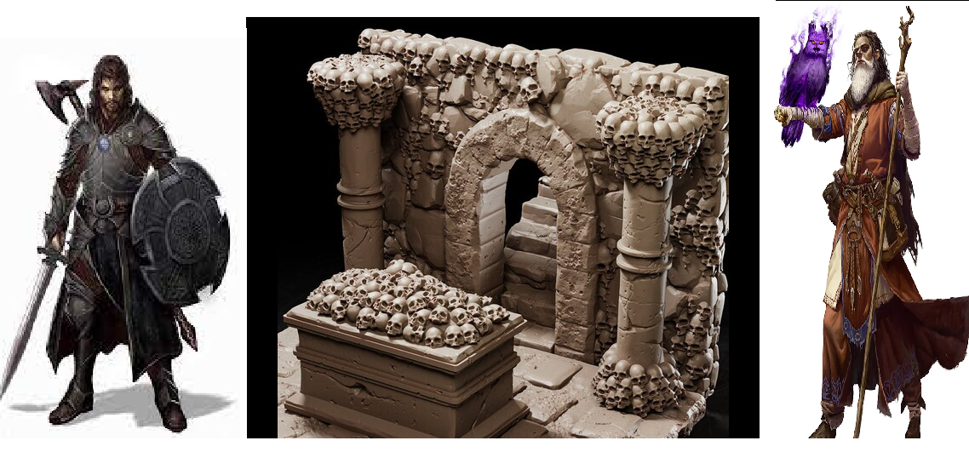
The Adventure of Salvatore
Pitch Date: October 22, 2023 Update November 5, 2023
Release Date: March 3, 2024 Commits: 30 (+7)
Team Lead: Vince McKeown 3 Contributor (+1)
1
2
3
4
5
6
7
8
9
10
11
12
13
14
15
16
17
18
19
Done

Slide 2
Contributions This week -Vince McKeown
Player can move in all directions now
Player drawn N, SW S, SE, S, and E
Need to draw NW, and NE
Added bookshelves, weapon racks, barrels, and sacks

Slide 3

Contributions This week -Christer McFunky Pants
Refactored Minimap
Used on offscreen canvas
All minimap code contained in minimap.js
Vignette Effect

Slide 4
Join us in Channel!
Channel is Team-js-Adventure-Of-Salvatore

